Slide 1
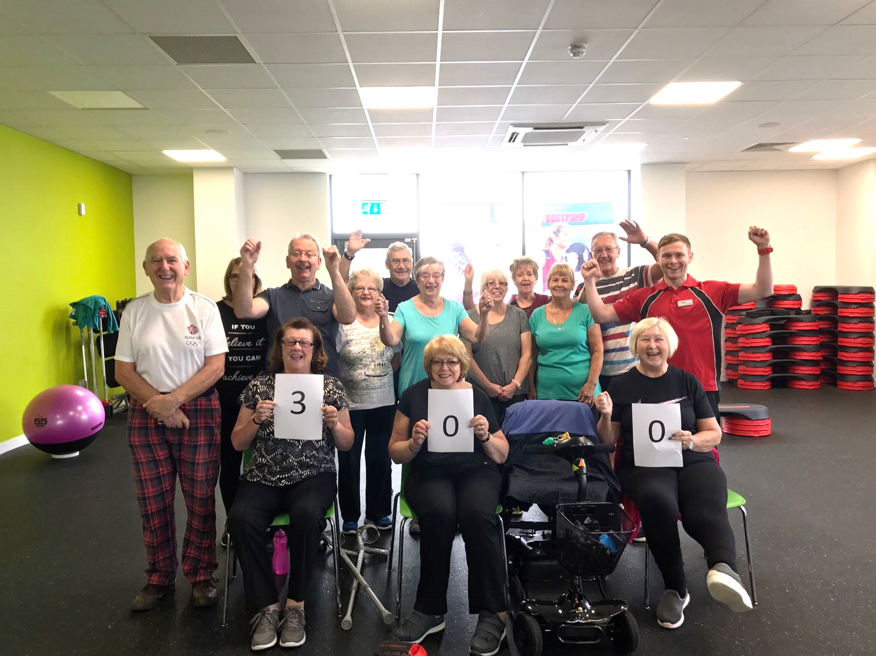
Active Forth: Exercise Referral Programme
Scott Burton
Physical Activity Coordinator

Slide 2
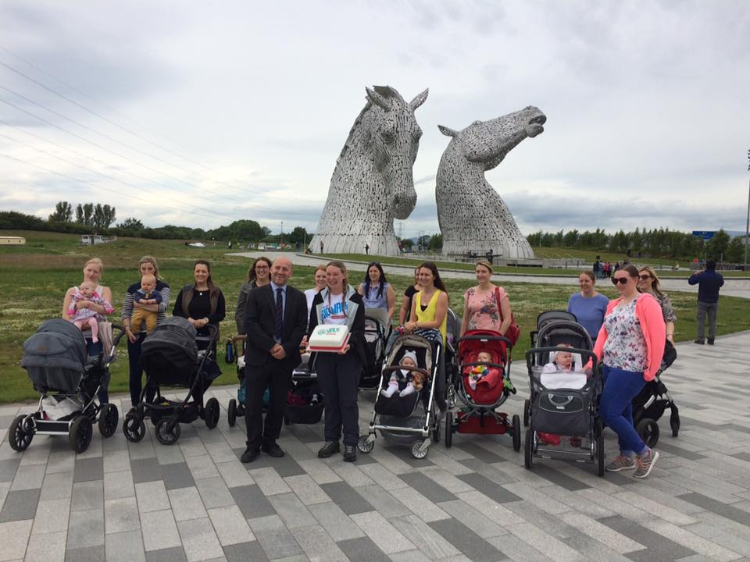
Falkirk Community Trust
Charitable Organisation
Step Forth Walking Programme
Health Walks
Nordic Walking
Buggy Walking Groups
Health & Fitness
Libraries
Parks
Active Schools
Sports Development
The Kelpies!

Slide 3
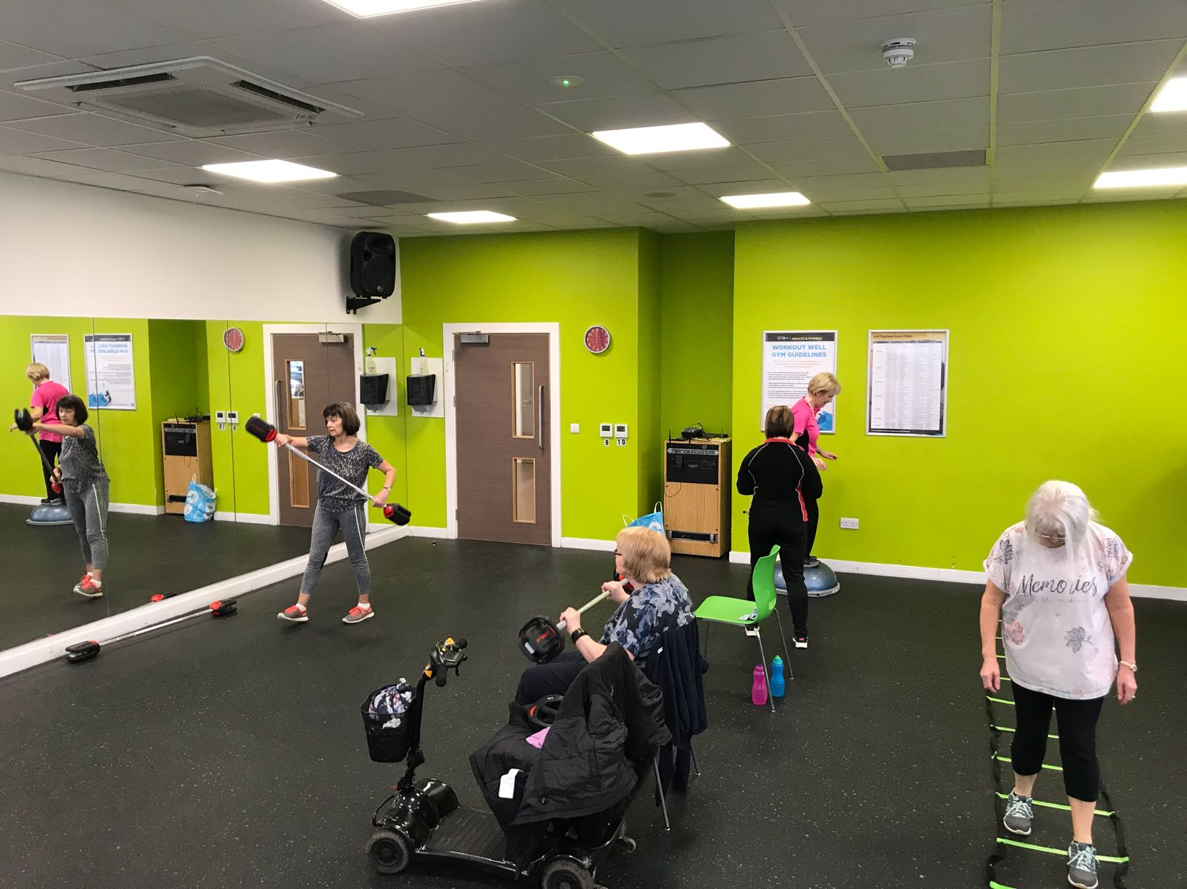
You Don’t Know What You Don’t Know
Active Forth (Falkirk Exercise Referral Programme)
Exercise Referral Programmes in Scotland
What are they?
Why do we need them?
Who are referred to us?
Modes of Exercise
Research Data
Active Forth Circuit Class

Slide 4
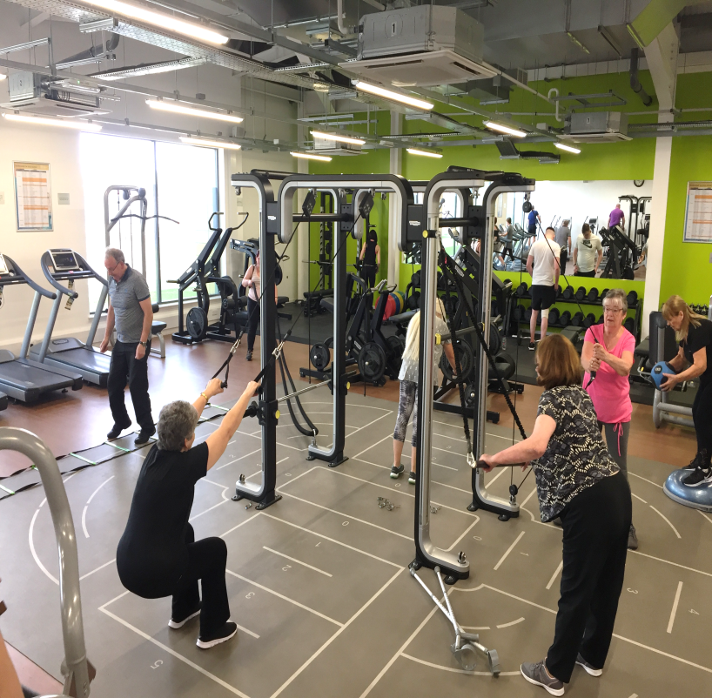
Our Referral Process
Referred by health professional
Length- 12-24 weeks
Personalised exercise programme
Reviews throughout
Classes: Otago, Strength & Balance
Aquafit, Walking Netball, Hydropool
Available to all patients and determined by their health professional and exercise specialist
Active Forth Omnia gym class

Slide 5
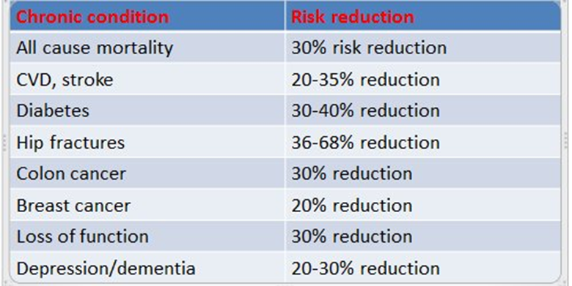
Benefits Of Community Programmes
Cardiac Rehab- 12 weeks
Pulmonary Rehab- 12 weeks
Otago- 6-12 weeks
Back Into Action- 8 weeks
Back Into Motion- 8 weeks
Stroke Rehab- 6-12 weeks
Physiotherapy- Discharged
What do patients do next?
Have they achieved positive habits to last them a lifetime?
WHO Global action plan for physical activity 2018-2030

Slide 6
Who are referred?
Instructor Qualifications
Level 3
Exercise Referral Qualification
Level 4
Cardiac Rehabilitation
Stroke Rehabilitation
Cancer Rehabilitation
Mental Health
Falls Prevention
CPD Updates: Parkinson’s
Referral criteria

Slide 7
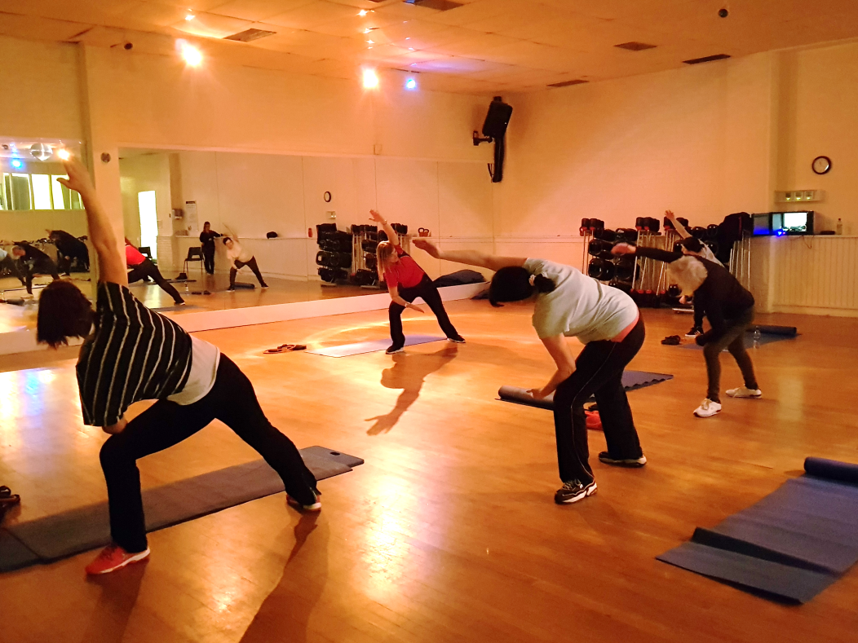
Good News
Active Forth has given me the confidence to exercise again and has improved my health. I manage my pain better and feel great after classes. Maggie (Multiple Sclerosis), 66.

Slide 8
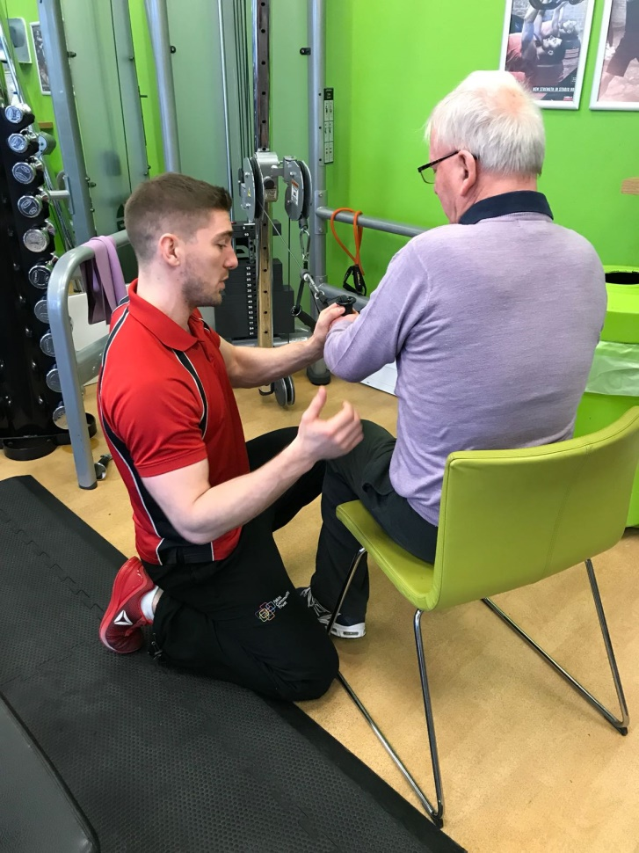
Good News
I was referred to Active Forth after suffering a stroke. I had no use of my left arm and I felt really down and was frustrated by lack of mobility and inability to do simple tasks. I attend the gym twice a week and attend the strength and balance class. My stamina has greatly increased as well as the strength and the grip in my left hand. I would recommend Active Forth to anyone who wishes to improve their overall health. Robin, 72.
Questions?

