Slide 1
Bone Health
Kirstie Stenhouse
Fracture Liaison Practitioner NHS Forth Valley
@Kirstieahp
kirstie.stenhouse@nhs.net

Slide 2
Scottish Standards of Care for Hip Fracture Patients 2018
Standard 10: Every patient who has a hip fracture has an assessment or referral for their bone health prior to leaving the acute orthopaedic ward.

Slide 3
At the end of this session you will:
Be able to support an individual to improve their bone health and decrease their chance of sustaining a further fragility fracture.

Slide 4
Osteoporosis is a progressive systemic skeletal disease characterised by low bone mass and micro-architectural deterioration of bone tissue, resulting in increased bone fragility and susceptibility to fracture.

Slide 5
What is a fragility fracture?
A fragility fracture is a type of pathological fracture that occurs as result of normal activities, such as a fall from standing height or less.

Slide 6
https://www.youtube.com/watch?v=-ZexNjgY0mI

Slide 7
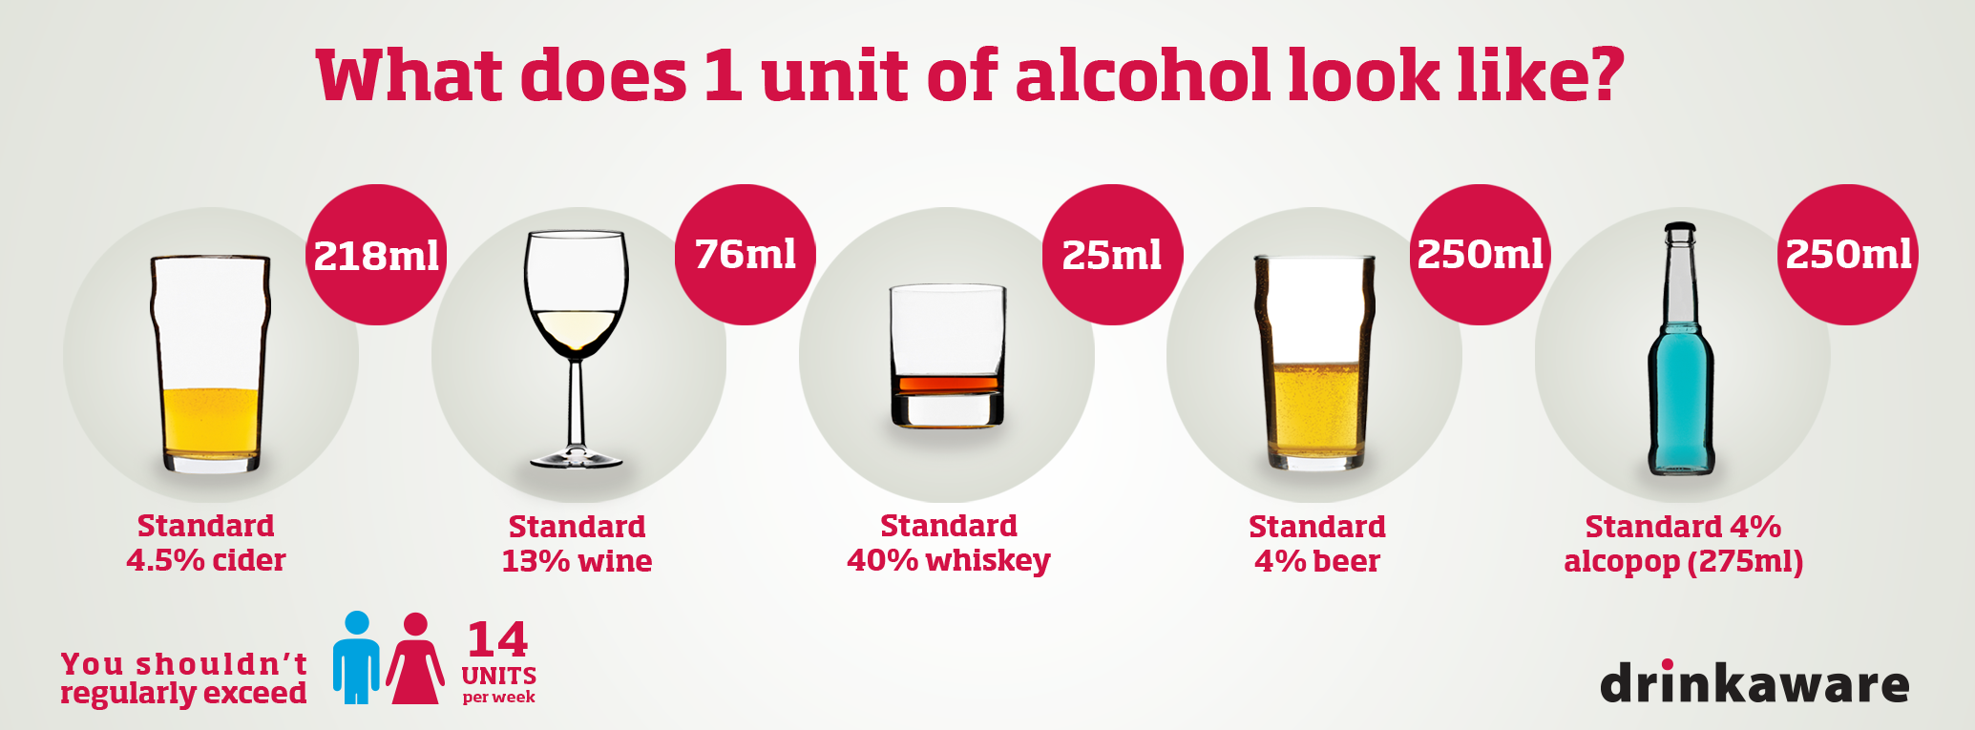
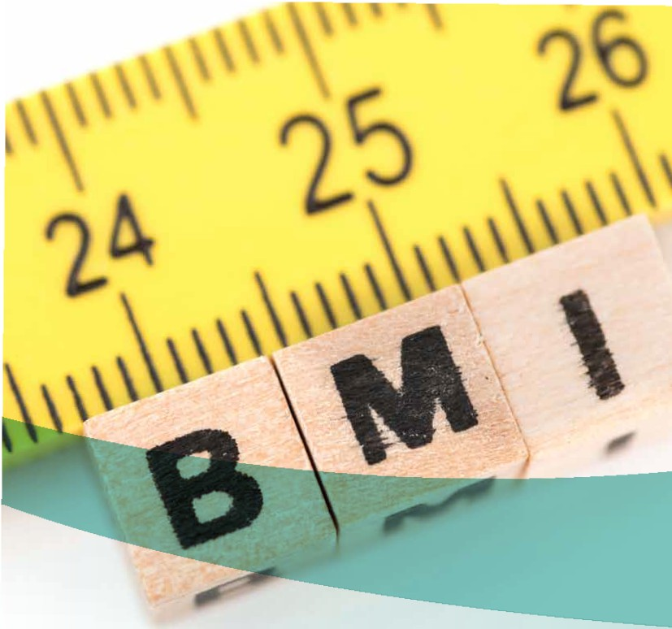
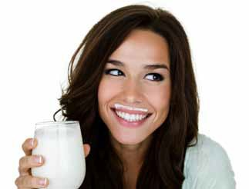

Slide 8
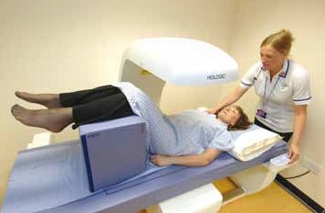
Dual Energy X-ray Absorptiometry (DXA scan)
No need to get undressed
It is not a tunnel
It is quick
The staff are lovely

Slide 9
Medications – Bisphosphonates (alendronic acid)
Reduces chance of fracture by half
Compliance is a major issue
Must be taken correctly 80% of the time to be effective
Taken once per week, on the same day each week
Taken on an empty stomach with a full glass of water
Keep upright for 30 minutes afterwards
No other food, drink or medications for half an hour afterwards
No calcium tablet within 4 hours
Think about home care packages – can family assist?

Slide 10
Scottish Standards of Care for Hip Fracture Patients 2018
Standard 10: Every patient who has a hip fracture has an assessment or referral for their bone health prior to leaving the acute orthopaedic ward.

Slide 11
What can YOU do to reduce the risk of fracture?
Have conversations with individuals and their family about bone health and lifestyle choices.
Facilitate correct compliance with bone health meds.
Find out which services locally support individuals in lifestyle choices and signpost to them.
Look after your own bones!

Slide 12
Further training and information
Lots of information and free booklets from the National Osteoporosis Society www.nos.org.uk
National Osteoporosis Society e-training
foundation and advanced modules
www.nos.org.uk/health-professionals/fracture-prevention-practitioner
Learn pro modules NHS Scotland
Information on the implications of osteoporosis for moving and handling activities with older people in acute care www.lydiaosteoporosis.com/home

