Slide 1
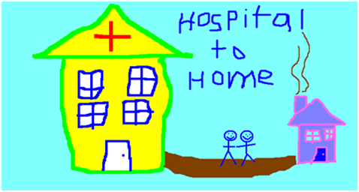
Home First

Slide 2
Definition
“Where people who are clinically optimised and do not require an acute hospital bed, but may still require care services provided with short term, funded support to be discharged to their own home or another community setting. Assessment for longer term care and support needs is then undertaken in the most appropriate setting at the right time for the person”

Slide 3
WHY Home First?????
Demographics of an ageing population
12% of patients decline in ADL function between admission and discharge
Delirium after admission 4-29%
Hospital acquired infections (5-10%)
One or more adverse drug reaction in 19% of inpatients

Slide 4
Otherwise known as.........
Discharge to assess
Safely home
Step down

Slide 5
Home First Approach
Action focused daily board rounds
Minimal DC goal
Realistic EDD
Planning DC from Day 0/1
Early support for homecare on DC

Slide 6
Principles of Home First Approach
Set minimum discharge goals on day 1
Each board round – ask why this person requiring acute care ? is there any other place this intervention could be delivered to enhance the person’s experience.
Full team should be focused on achieving these goals – this included patients and family
Ensure AHP guidance for improving functioning are carried out throughout 24 hours – enablement approach

Slide 7
Principles of Home First Approach
Ensure team identify support needs and ensure these have been addressed prior to patient completing the acute phase of their care
The MDT need to include – OT. PT, ward nurse, DF, ACE nurse, community representative if available. – its important to allow these individual to develop as a team.

Slide 8
Benefits

Slide 9
Benefits
Encourages health and social services to work together for the best outcomes and experiences for individuals through joint approaches
Improves system flow by enabling patients to access urgent care at the time they need it
Sharing responsibility, risks and skills across partners leads to innovative and creative solutions that deliver safe, effective care and support

