Slide 1
Sedentary behaviour Challenges & impact
National Hip Fracture Workshop
June 7th 2018
Juliet Harvey @DrJulietHarvey
Practice Development Physiotherapist NHS GGC

Slide 3
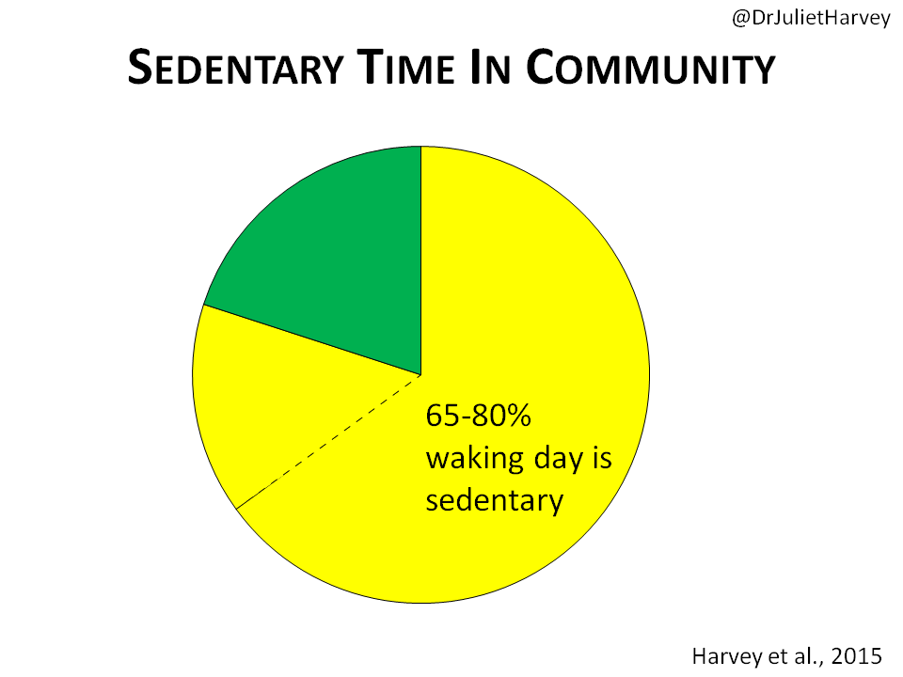
@DrJulietHarvey
Sedentary Time In Community
Harvey et al., 2015

Slide 5
@DrJulietHarvey
#EndPJParalysis
Notes:
Clare Rae & Gillian Walker Cover EndPJParalysis in AM

Slide 9
@DrJulietHarvey
Intervention Examples
Brief Intervention (Senior USP Project)
Frail Older Adult Intervention Pack Sample & Results of Study (Harvey 2016, PhD Project)
Ward Based My Active Care Plan (McInally 2017, I-Hub Improvement Project)

Slide 10
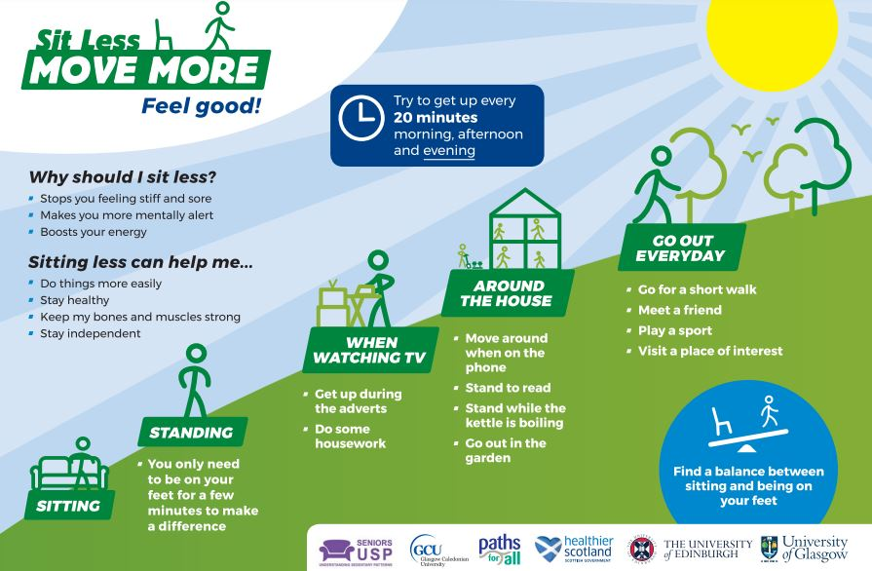
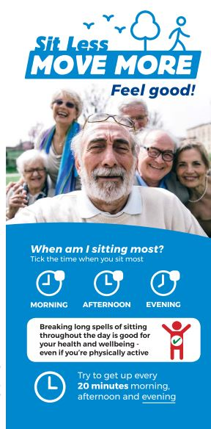
@DrJulietHarvey
How can we intervene
Education is good - if someone is active anyway this may be enough.
For example, Senior USP developed a programme for Paths for All (@PathsforAll) walk leaders providing education to walking groups on sedentary behaviour.

Slide 11
@DrJulietHarvey

Slide 12
@DrJulietHarvey

Slide 13
@DrJulietHarvey

Slide 14
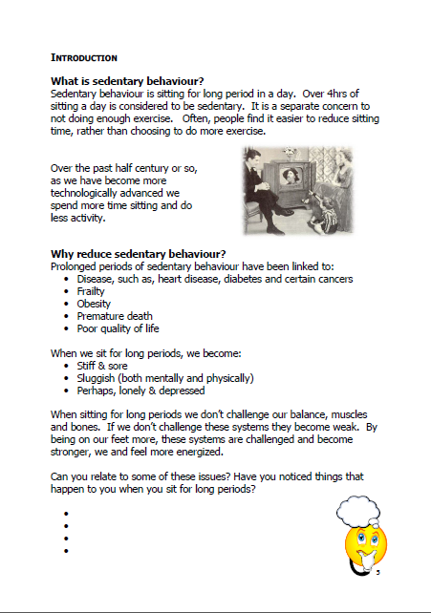
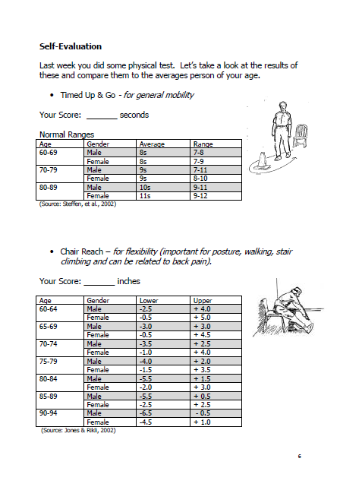
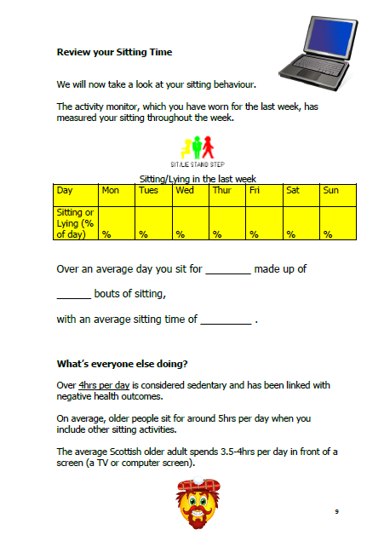
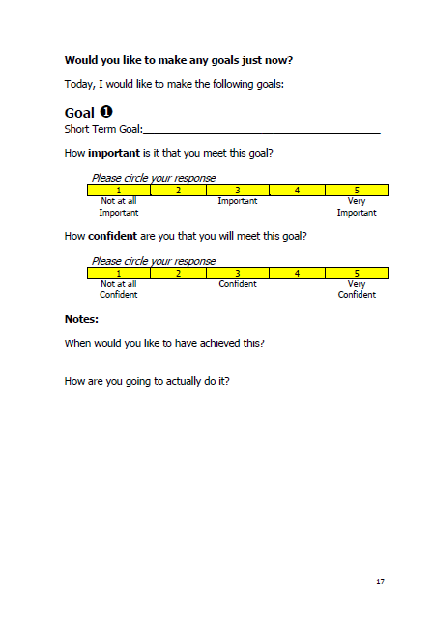
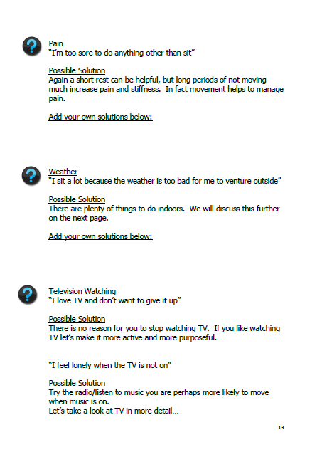
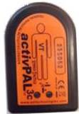
@DrJulietHarvey
Intervention
Personal targets were accompanied by
relevant sitting time goals.
Individuals chose to break their sitting every 30mins to 1hr, with break targets being between 1 & 5 mins(upright).
Results published in Harvey et al., 2018

Slide 15
@DrJulietHarvey

Slide 16
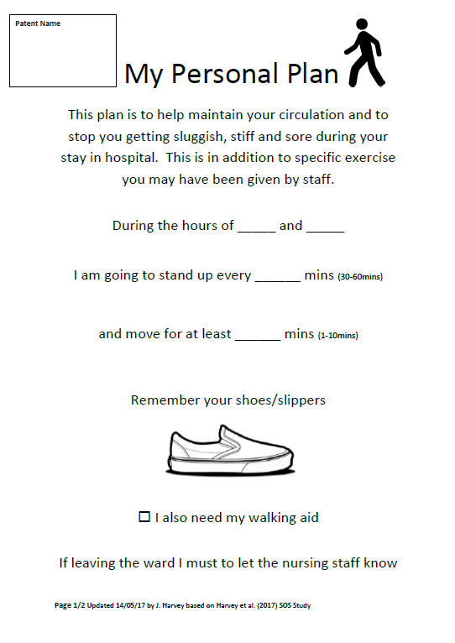
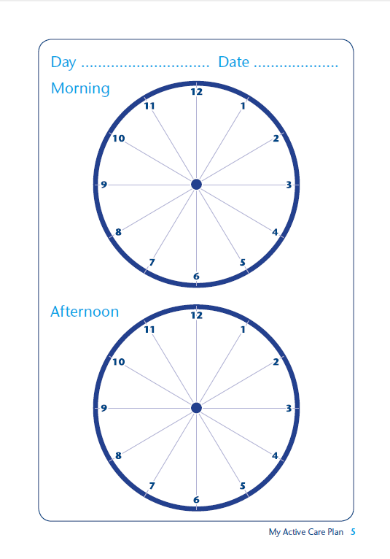
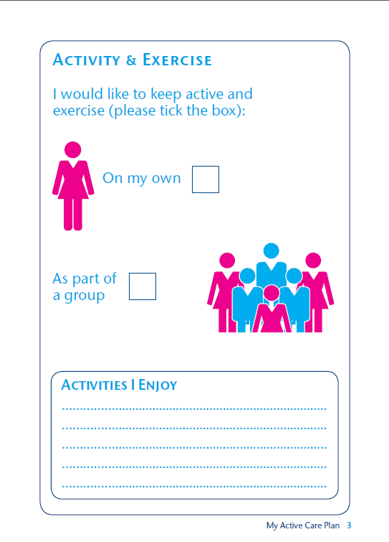
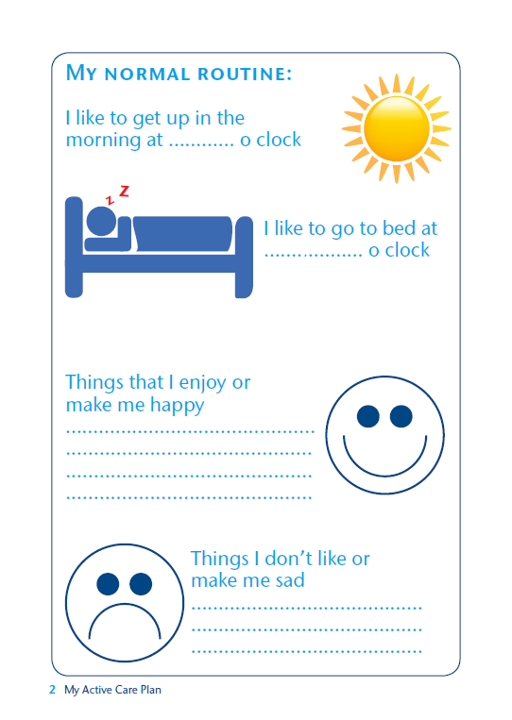
@DrJulietHarvey
My Active Care Plan
L.McInally 2017
Results to be published
@LianneMcInally1

Slide 18
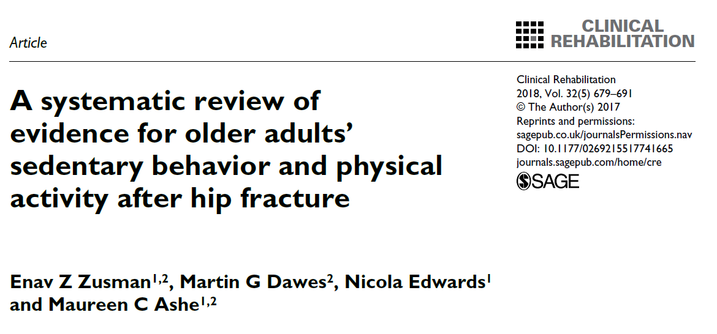
Recommended Reading: SB & Hip Fracture

Slide 19
@DrJulietHarvey

