Slide 1
“When Days Were Hip”
Clare Rae –Head of Physiotherapy, NHS Lanarkshire
Gillian Walker - Occupational Therapy Team Lead, Royal Infirmary Edinburgh

Slide 2
Notes:
Back to the 90s for a quick reminisce. Uni days

Slide 3
The 90s – 25 years!
Notes:
Lots of changes, not all positive – hip fracture stats.....

Slide 4
9125 days of hip fracture
Scottish hip fracture audit began in 1993 in 4 hospitals
In 1994, 5400 people aged 55 and over fractured a hip in Scotland
Further rise has resulted in more than 8000 each year in the over 50s
Notes:
25 years - 9125
Scottish Needs Assessment Programme Sept 1997

Slide 5
Mortality Rates
48 per cent of people over 85 die within one year of hospital admission (Clark et al 2014)
Hip # is the commonest cause of injury related death in over 75’s – approx 7 in every 100
Only 50% return to their previous level of mobility
Notes:
Functional implication

Slide 6
Time in hospital
Access targets are about time
Waiting lists are measured in time
Harm is frequently caused as a consequence of time ill spent
Need for change & earlier intervention - hip fracture standards 2018
Notes:
We treat elderly pts as if they have all the time in the world but they are the ones with less time. Beds are not capacity, too often they are places where patients spend their time waiting for things to happen.
Standard 8: Mobilisation has begun by the end of the first day after surgery and every patient are physiotherapy assessment by end of day two.
Standard 9: All patients with a hip fracture have an Occupational Therapy (OT) assessment by the end of day three following admission to ward.

Slide 7
#Last1000days
https://vimeo.com/228562447
Notes:
Watch the video and take note of the number of days each person has

Slide 8
#Last1000days
If you had 1000 days left, how many of them would you choose to spend in hospital?
What personal experience have you had related to waiting as a patient/relative?

Slide 9
What is the most important currency in healthcare?
“Patient’s time”
Notes:
Beds are not capacity, too often they are places where patients spend their time waiting for things to happen

Slide 11
Professor Brian Dolan

Slide 15
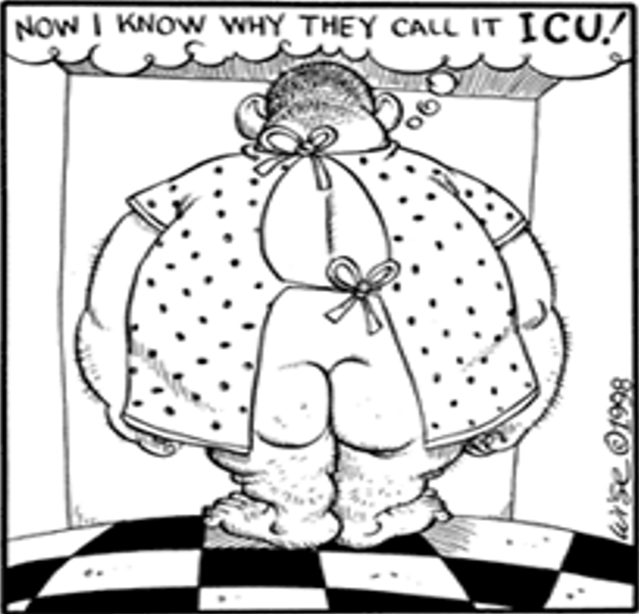

Slide 16
Benefits
Patient
Reduce harm
Reduce length of stay
Empower
Increase Dignity
Psychological/mind set
Maintain functional
independence
Staff/organisation
Reduce length of stay
Improve flow, reduce
boarding, late night transfers,
pre noon discharges
Improve safety
Reduce laundry costs
In line with 6EA ongoing work
Reduce complaints
Reduce burden on Social
Services
Meet Government targets

Slide 18
#Red2Green
Makes visible any delays in the patients journey through the system.

Slide 19
Actioning red2green
First ward/board round starts with all pts marked red
Ward/board round should identify how to progress the pts day to green
If red, MDT make effort to resolve problem in real time
Record red and green in visual manner on board
At end of each week top 5 constraints should be considered by senior operational managers

Slide 20
SAFER
S – Senior Review. All pts have a senior review by midday to make management and discharge decision
A – All pts will have an expected date of discharge and clinical criteria for DC
F – Flow of pts will commence at the earliest opportunity
E – Early discharge. 33% of pts will be discharged from inpatient base by midday
R – Review. A systematic MTD review of pts with extended LOS with a clear home first mindset

Slide 22
Time in Healthcare
Time is most important currency in healthcare
Some – is not a number
Soon/ongoing – is not a time
Expected date of d/c not estimated date of discharge

Slide 23
“Hip fracture injury is set to increase in number by approximately 50% in the next 17 years” – Graeme Holt

Slide 24
Thank you!

